Slide 1
TIM 101
January 25, 2018
Water and Energy Research
Prof. Brent M. Haddad
Environmental Studies
Office Hours: M 8:30-10:30 and Th 9:40-11:00
Natural Sciences 2, Rm 493
bhaddad@ucsc.edu

Slide 2
The Fresh Water Management Challenge
Water doesn't arrive where, when, and in the quality and quantity in which it is needed.

Slide 3
The Fresh Water Management Challenge
Water doesn't arrive where, when, and in the quality and quantity in which it is needed.
Therefore, ongoing intervention in natural systems is needed to meet society’s water needs.

Slide 4
The same can be said for Energy:
Energy doesn't arrive where, when, and in the quality and quantity in which it is needed.
Therefore, ongoing intervention in natural systems is needed to meet society’s energy needs.

Slide 5
Withdrawal vs. Consumption An Important Distinction
Commercial
Domestic
Withdrawal
(BGD)
1
7
Thermoelectric
Irrigation
3
107
1
4
3
Water Consumption (BGD)
Mining
Industrial
Livestock
Source: Jared Ciferno,NETL
Sources: ¹USGS, Estimated Use of Water in the United States in 2000, USGS Circular 1268, March 2004
²USGS, Estimated Use of Water in the United States in 1995, USGS Circular 1200, 1998

Slide 6
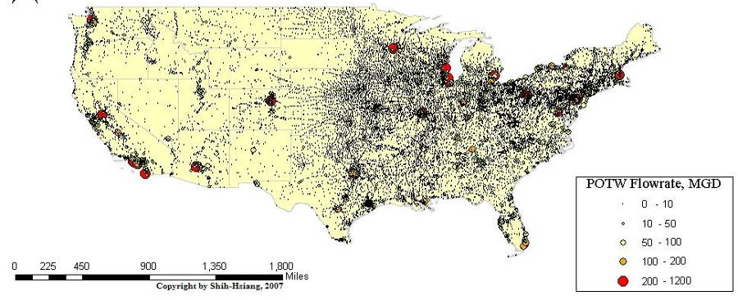
Water Flowing Through Cities, U.S.
Map by Shih-Tsiang; water flowing through wastewater
treatment facilities in US, 2007.

Slide 7
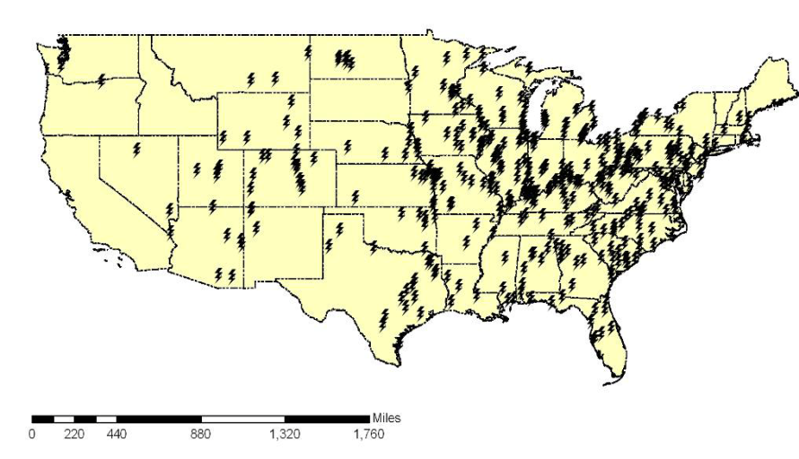
Pitt/Carnegie Mellon Study: water for 110 proposed new power plants
Findings
11.4 trillion gallons of municipal wastewater collected and treated annually in U.S.
On average, one fairly large POTW can completely satisfy the cooling water demand for each of 110 proposed power plants (EIA, 2007)
Inventory of available wastewater
http://www.netl.doe.gov/technologies/coalpower/ewr/water/pp-mgmt/pubs/06550/42722FSRFG063009.pdf
Inventory of water needs

Slide 8
What are local natural
water systems doing?

Slide 9
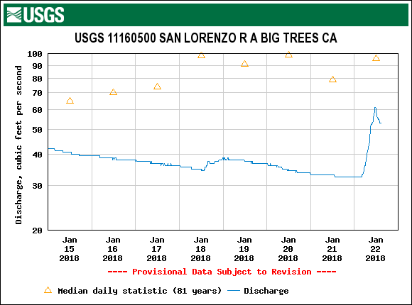

Slide 10
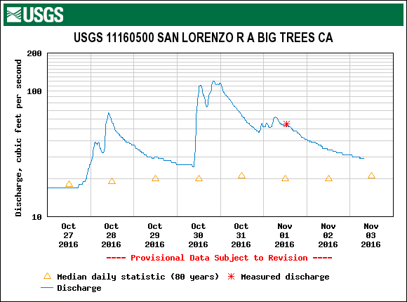

Slide 12
City of Santa Cruz average daily water production:
10 million gallons per day
(1 cubic foot of water = 7.48 gallons)
10 mgd ~ 15.5 cfs
Current actual….6 mgd ~ 9.28 cfs

Slide 13
How do cities meet their many, sometimes-conflicting water needs?
Local surface and groundwater
Conservation
Reuse
New supply
Re-prioritizing existing uses

Slide 14
How do cities meet their many, sometimes-conflicting water needs?
Local surface and groundwater
Conservation
Reuse
New supply
Re-prioritizing existing uses
Each of these strategies requires a mix of technology, policy, economic incentives, and public acceptance.

Slide 15
Examples of technologies
Pumps/piping/storage
Flood protection
Sensors/measurement/analytics
Treatment
Emergency response

Slide 16
Examples of policies
Public Information
Conservation campaigns or rules
Defining water rights to achieve public goals on use or quality after use

Slide 17
Examples of economic incentives
Water Pricing – usage and fixed costs and fees
Financial penalties for overuse or polluting

Slide 18
Examples of “public acceptance”
Water Reliability Standards
It’s “OK” to have severe water cutbacks in a severe drought.
It’s “OK” to have water that doesn’t taste perfect.
OR – it’s NOT OK to ever compromise on water supply and quality.

Slide 19
WATERLAB
The Water Teaching and Research Laboratory
Operated by the Center for Integrated Water Research
University of California, Santa Cruz
In collaboration with
Watsonville Water Resources Center
City of Watsonville

Slide 20
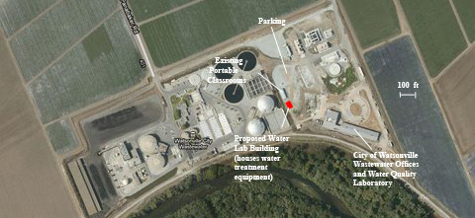
Watsonville Water Resources Center has the space, location, and lab facilities to accommodate a water research laboratory.
Notes:
- A 500,000 GPD double-pass RO unit previously used by the army at Fort Richardson, Alaska. It provided purified water to cooling towers of the Fort’s power plant.
- A 14,000 gpd Army Reverse Osmosis Water Purification Unit.

Slide 21
Notes:
- A 500,000 GPD double-pass RO unit previously used by the army at Fort Richardson, Alaska. It provided purified water to cooling towers of the Fort’s power plant.
- A 14,000 gpd Army Reverse Osmosis Water Purification Unit.

Slide 22
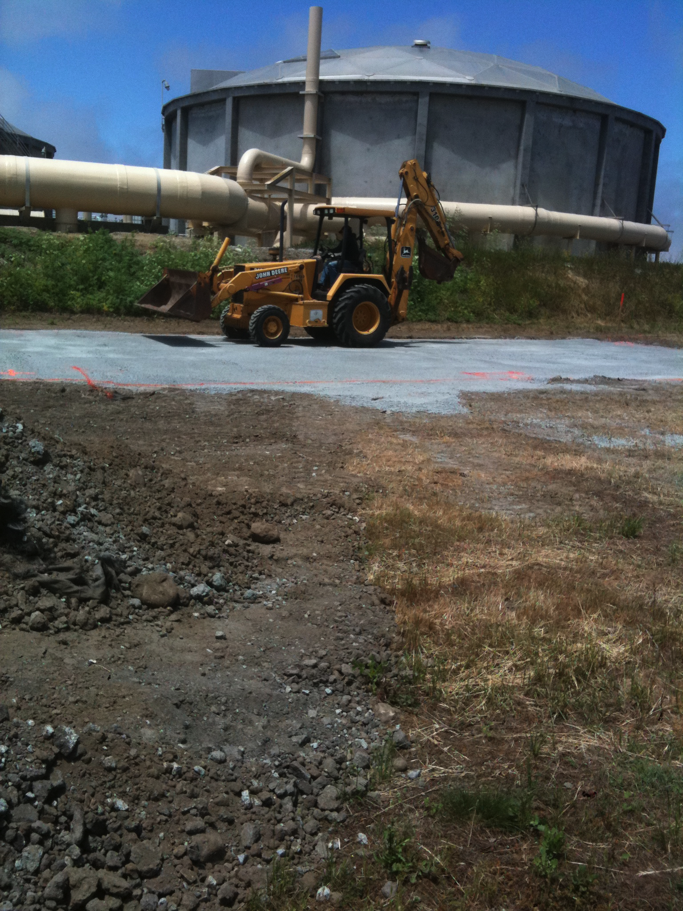
June, 2011, construction begins on the WaterLab Building

Slide 23
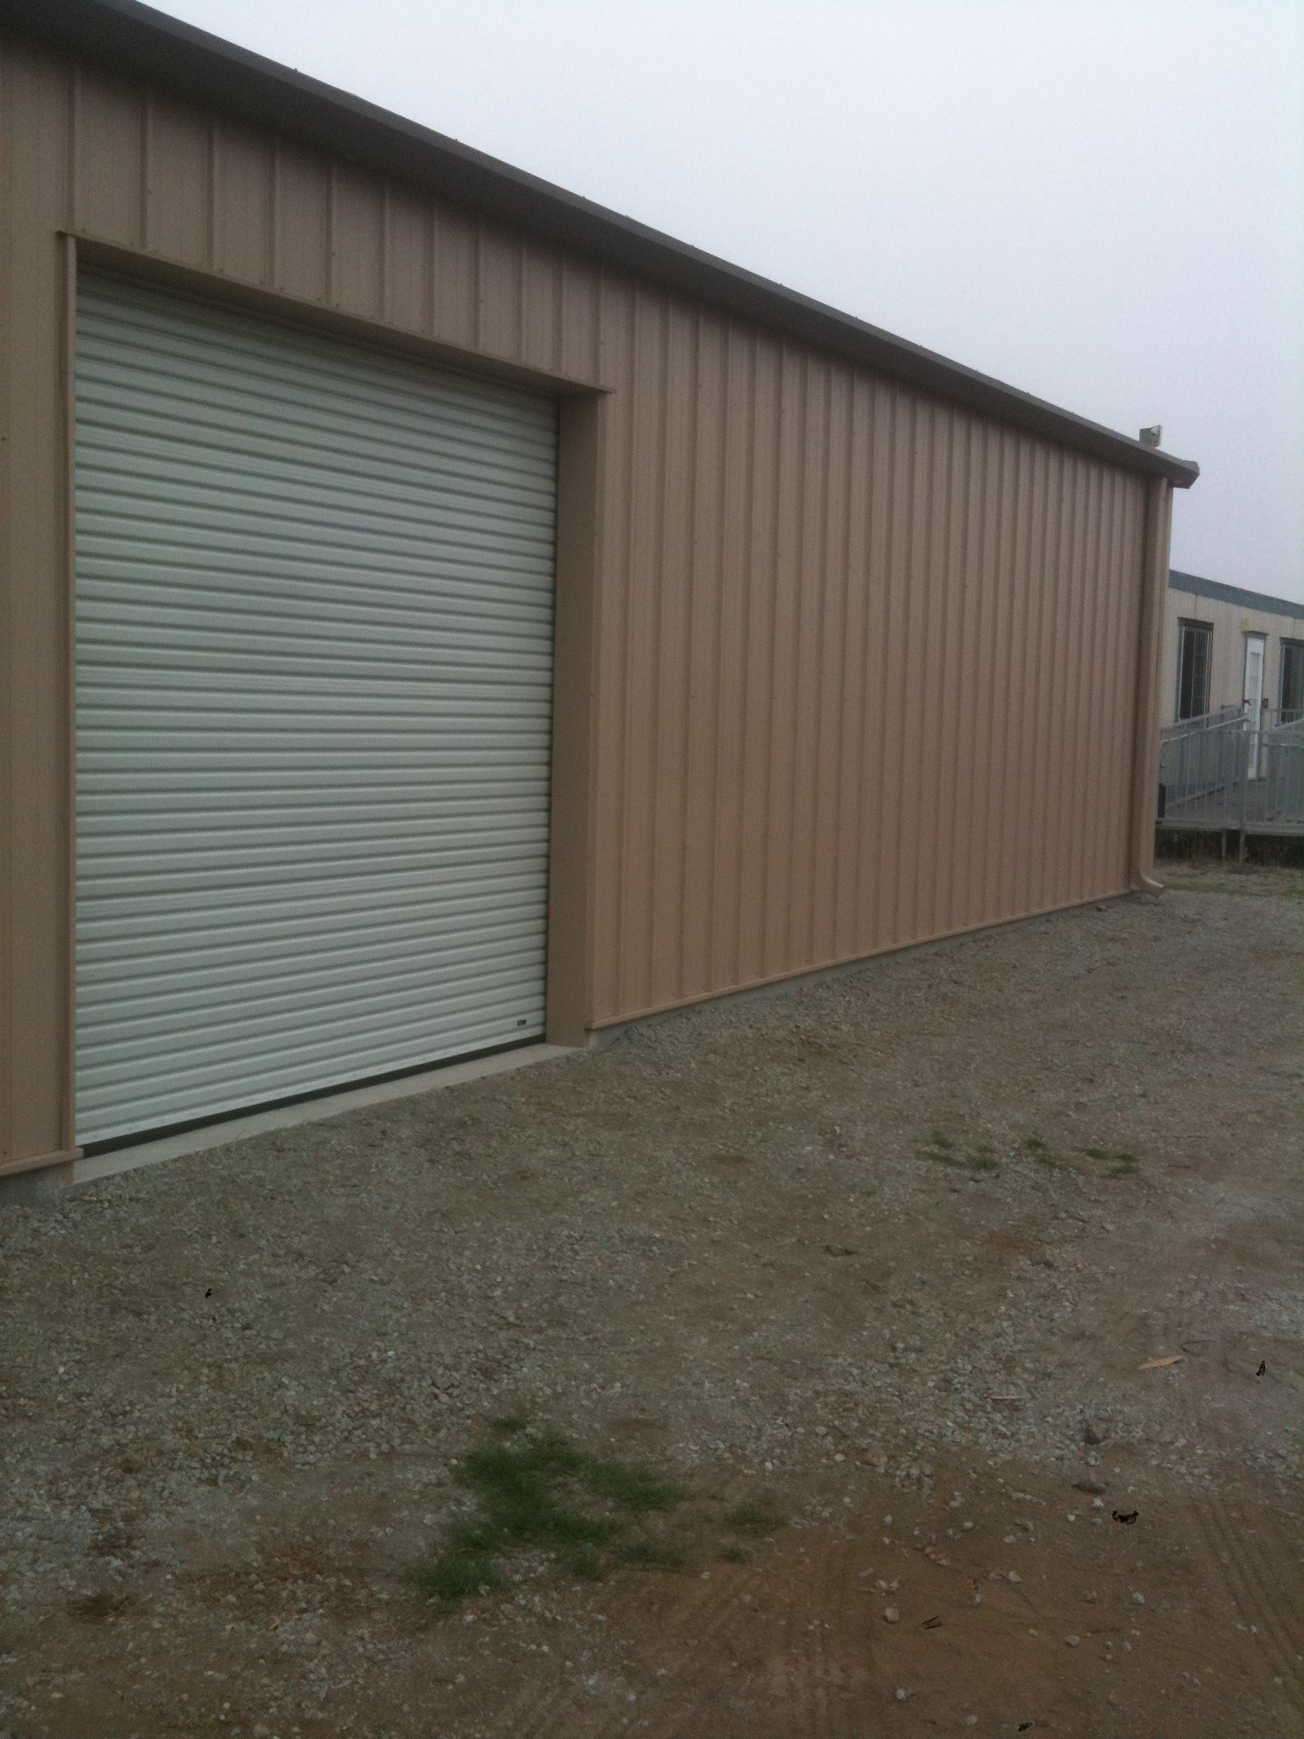
Early August, 2011 - building is up!
24’ x 55’

Slide 24
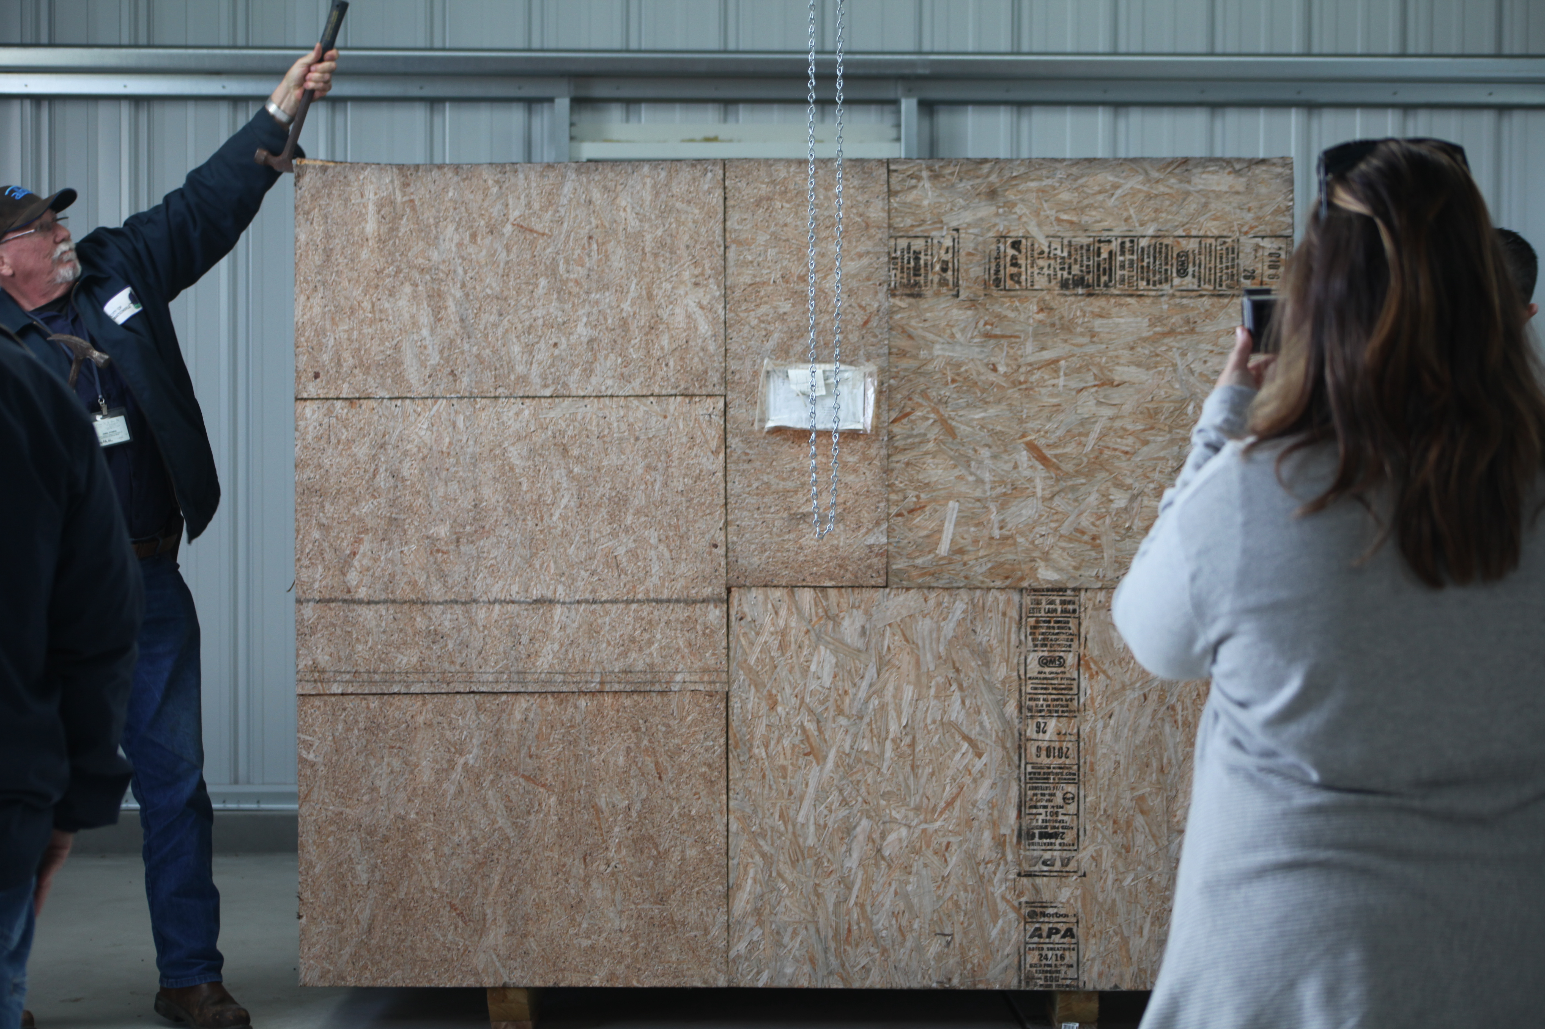
Late August, 2011: WaterLab has its first event - the
opening of the RO crate.

Slide 25
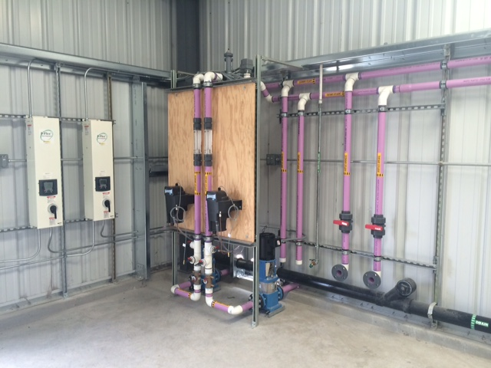
Current infrastructure

Slide 26
Current infrastructure
Plumbed supply of secondary and tertiary-treated wastewater
Up to 60 GPM flowrate
Initial testing for turbidity, pH, and conductivity installed.
Wastewater flows to headworks for treatment plant
4 research bays
Roll-up door

Slide 27
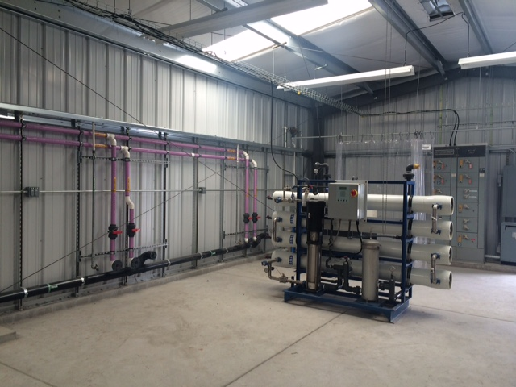
Current infrastructure
Research Bays

Slide 28
GOAL

Slide 29
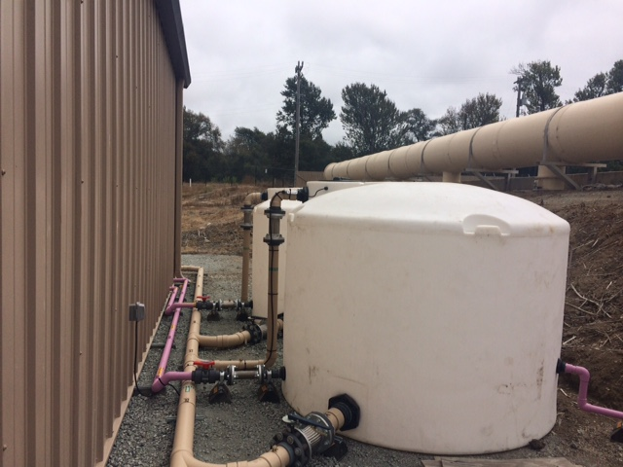
Current infrastructure

Slide 30
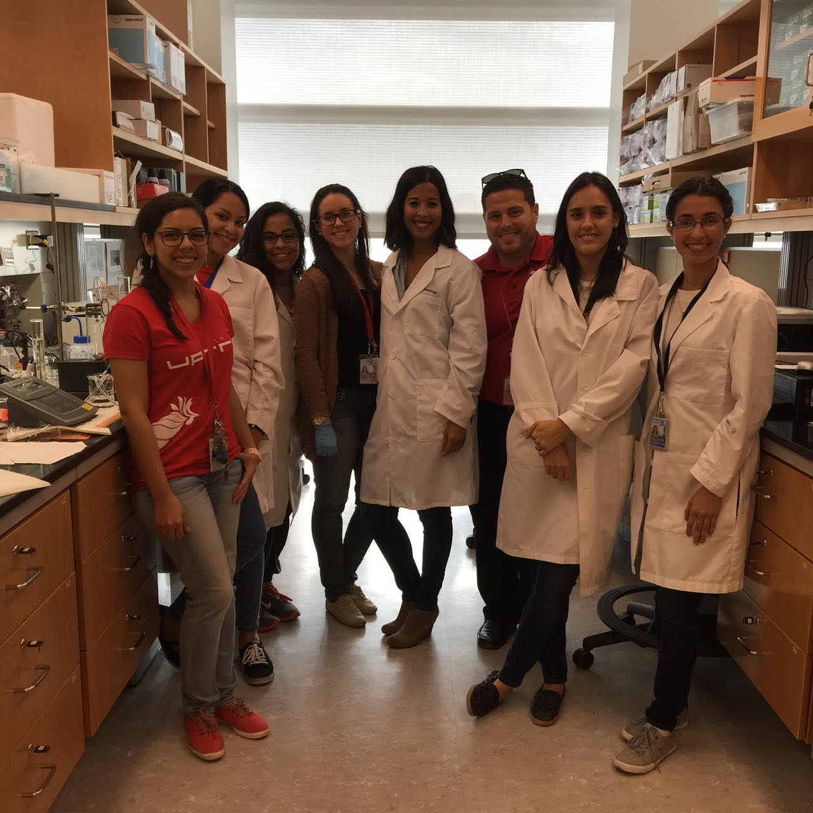
Current infrastructure
Outside:
Holding tanks
Slow-sand filtration unit
Nearby:
Regional water quality
testing facility
30-student classroom
Conference room

Slide 31
Thanks – Questions?

